Slide 1


Introduction to (Scientific) Programming with Python
Jelka Stojanov, Timo Flesch
MT 2020
University of Oxford

Slide 2
Outline
Why Python?
Practical
Part1: Intro to Python
Part2: Python for scientific programming
Part3: Python for statistical data analysis
Additional Resources

Slide 3






Why Python?
It’s a general purpose programming language,
used to power many of the apps you use every day!

Slide 4
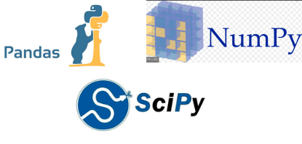

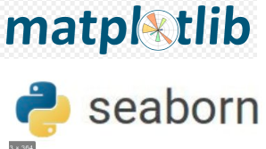
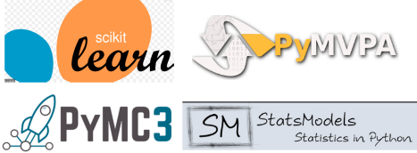
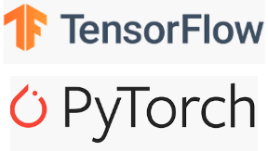
Why Python?
There are free(!!) add-ons for everything:
Organise and analyse numerical data
Create your own experiments!
Hop on the machine learning
hype train!
Make beautiful figures!
Perform sophisticated
statistical analyses

Slide 5


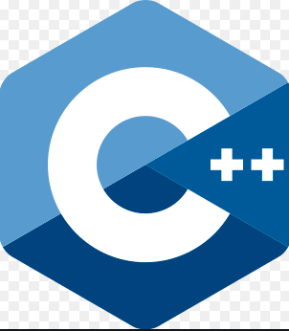


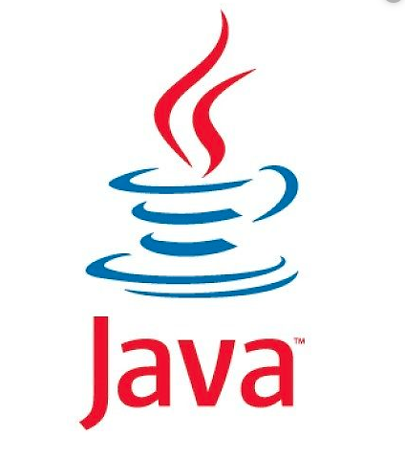
Why Python?
It’s just better than its competitors!
Matlab is very expensive! Python is free. When using the right
packages/addons, Python has the same functionality and syntax
as Matlab
>
Python is much easier to learn, as the syntax is less complex.
At least for science, there is a better community/ecosystem
Some python packages run C(++) code in the background, which makes them
almost as fast as their C++ counterparts
Python is a general purpose language. It can be used for almost everything.
R was developed for statistical analyses
Again, much simpler syntax. You can achieve the same results
with fewer lines of code

Slide 6
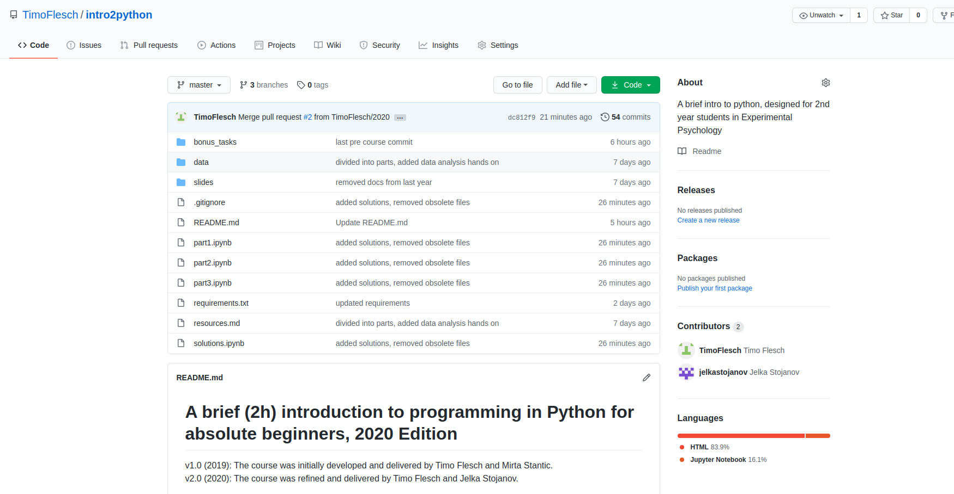
Python Practical
1. Go to http://www.github.com/timoflesch/intro2python

Slide 7
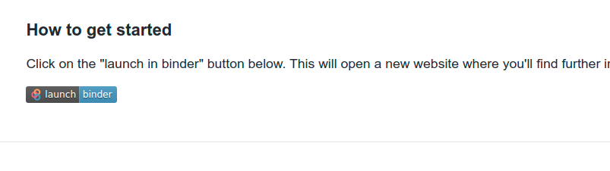
Python Practical
2. Click on “launch binder”

Slide 8
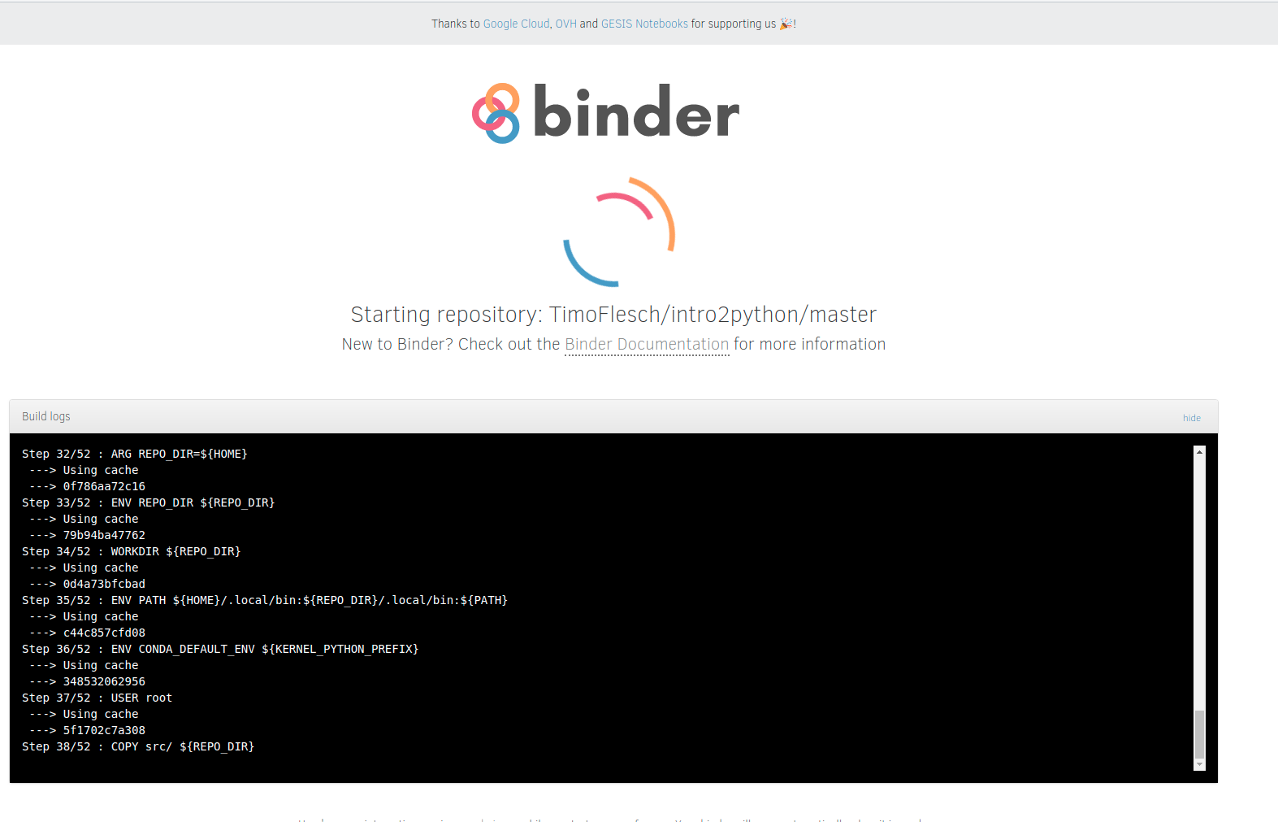
Python Practical
3. Stare for a while at this screen:

Slide 9
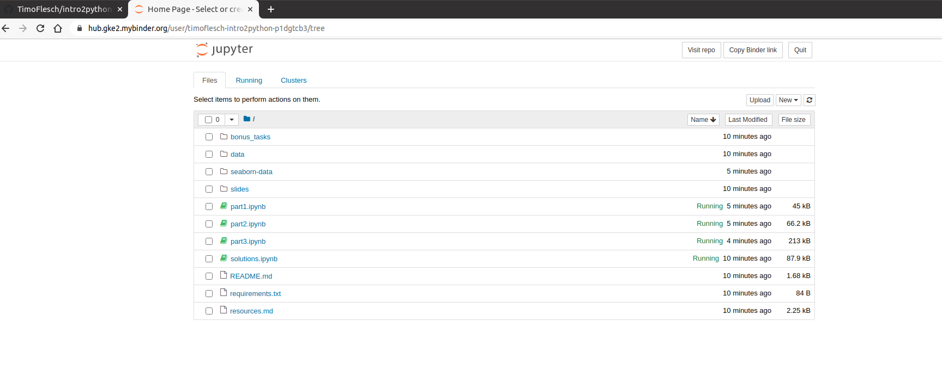
Python Practical
4. Now this screen should show up
From here you can open the worksheet that we have provided for you.
This will run an interactive python session in your webbrowser, where you can
write and execute your own python programs

Slide 10

Python Practical
4. Now this screen should show up
From here you can open the worksheet that we have provided for you.
This will run an interactive python session in your webbrowser, where you can
write and execute your own python programs
Click on “intro_to_python_students.ipynb”

Slide 11
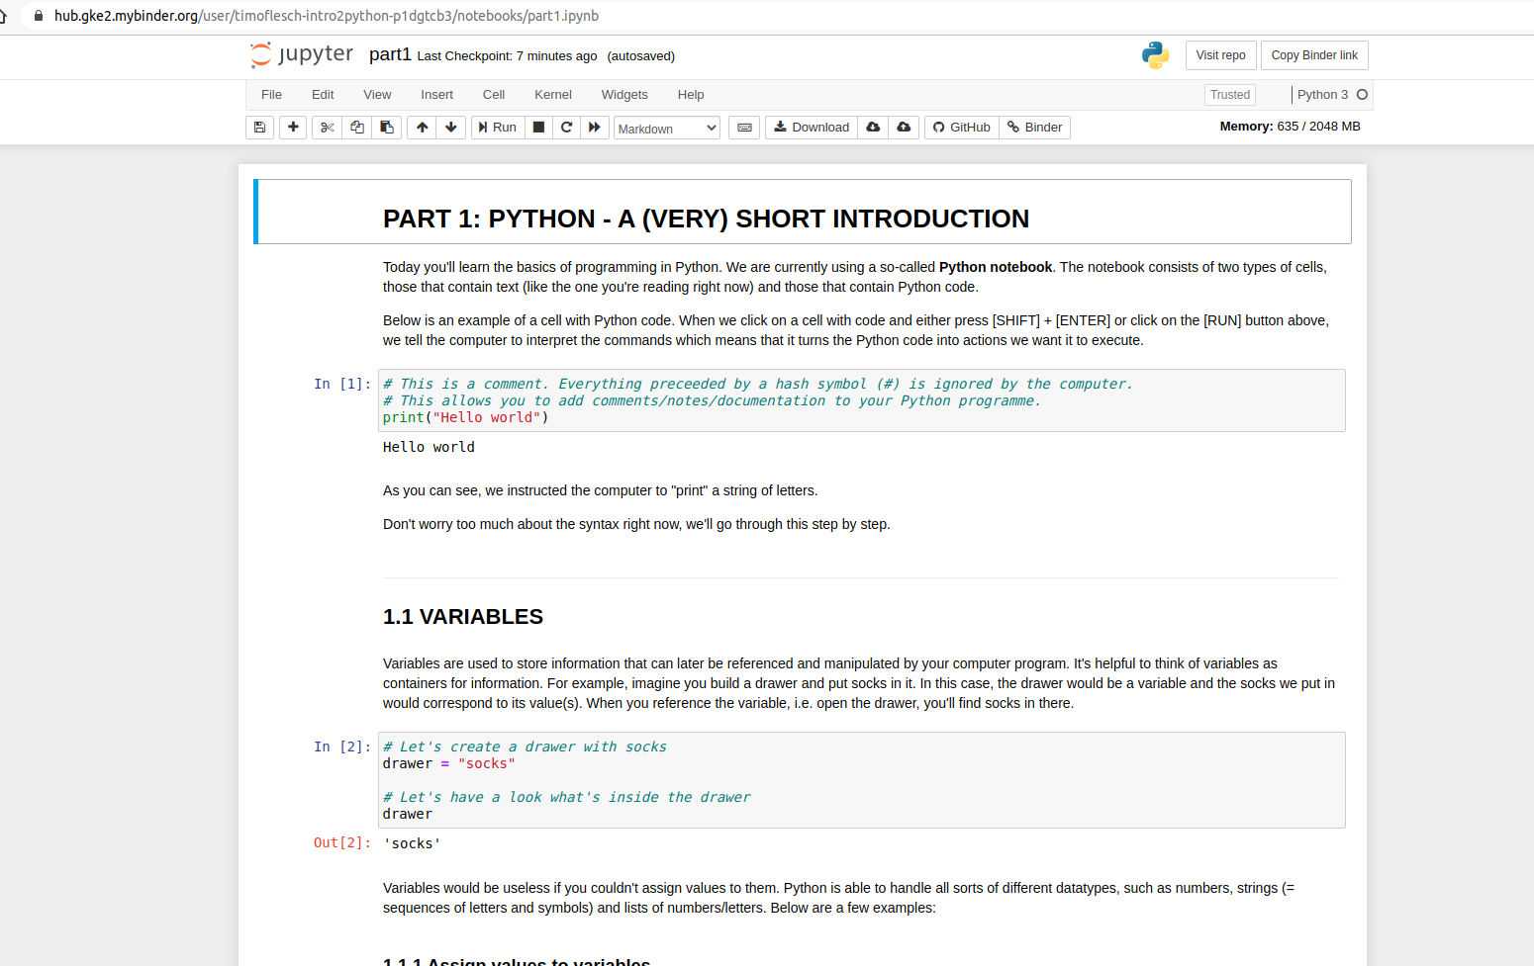
Python Practical
5. You’re now running an interactive worksheet with python code in your web-browser.
Have fun :-)

Slide 12
Outlook
Learn coding!
1. A complete course https://www.learnpython.org
2. ditto https://www.w3schools.com/python/
3. Advanced Course https://automatetheboringstuff.com
How to install Python
1. Just python https://www.codecademy.com/articles/install-python
2. The Jupyter notebook (the thing you've been working with today)
https://jupyter.org/install
3. Anaconda (a collection of useful packages and other software for data scientists)
https://www.anaconda.com/distribution/

Slide 13
Outlook
Text Editors
1. atom editor https://atom.io/
2. vscode https://code.visualstudio.com/
3. Sublime https://www.sublimetext.com/
All in One Solutions
(Similar to the Matlab interface or R-Studio)
1. Spyder (free) https://www.spyder-ide.org/
2. Pycharm (free basic and commercial pro version) https://www.jetbrains.com/pycharm/

Slide 14
Outlook
Coding Challenges
1. Hackerrank https://www.hackerrank.com/
2. Leetcode https://leetcode.com
Python for Psychologists
https://www.marsja.se/best-python-libraries-psychology/

